Slide 1

EHEDG Introduction

Slide 2
Content
Why Hygienic Design
Key Areas of Hygienic Design
Who is EHEDG
Organization and Activities

Slide 3
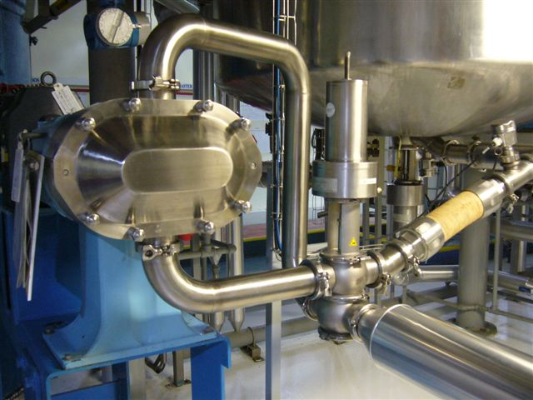
Why Hygienic Design?
Benefits of Hygienic Design (random order)
Hazard control (allergens, microbiological, chemical, foreign matter)
Improved product quality
Life cycle cost reduction
Quick change over execution
Pest control
Human safety
Housekeeping
Equipment reliability
Dietary compliance
(Halal, Kosher, organic)
Regulatory Compliance

Slide 4
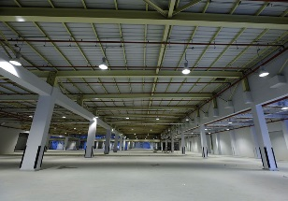




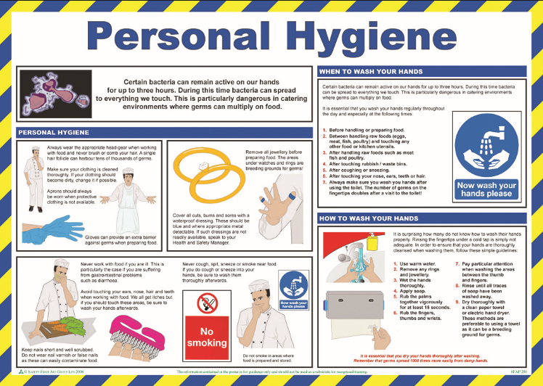
5 Key Areas in Hygienic Design
1
Hygienic Building Design | Hygienic Floors, Walls, Ceilings, Drains Zoning Food Defense, e.g. site security, fencing HVAC, Cabling, ducts, cabinets
Hygienic utilities | Water, Steam Air
Hygienic Equipment and Process design | Materials of construction Hygienic Welding Maintenance Cleanability and Drainability
Cleaning and Sanitation (disinfection) | Cleaning In Place (CIP) Design Dry cleaning, Cleaning out Place, Open Plant Cleaning Cleaning Procedures Cleaning Validation Cleaning and Sanitation chemicals
Personne(a)l Hygiene | Gowning, e.g. Hand/Shoe cleaning devices Culture Practices
2
3
4
5

Slide 5














































Who is EHEDG?
EHEDG was founded 1989 as a non-profit consortium of:
Equipment manufacturers
Food industries
Suppliers to the food industries
Research institutes and universities
Public health authorities and
governmental organisations
The mission: EHEDG enables safe food production by providing guidance as an authority on hygienic engineering and design.
The “Big 40” of 400 EHEDG
member companies to date

Slide 6
Overall objectives
To provide guidance on hygienic design and engineering to ensure food safety and quality
To offer a platform for the food industry to discuss issues on hygienic design
To develop guideline documents on hygienic design requirements and practices based on science and technology to ensure compliance to legislation
To maintain a transparent and unambiguous hygienic equipment certification scheme
To identify areas were hygienic design knowledge is insufficient and initiate and promote research and development in those areas

Slide 7
EHEDG Membership Benefits
Company members are authorized to use the EHEDG Company Member logo under agreed conditions. Note that the logo may not be used in a way of mistakenly implying EHEDG certification.
Companies initially avail of at least one up to four free main contact persons. Additional persons can be listed later on for active or corresponding Working Group membership and active involvement into the EHEDG regional activities
Publication of the company logo and name on the EHEDG website, conference programs, brochures, etc.
Hyperlink from the EHEDG website to the company website
Whole series of the EHEDG Guidelines in all language versions including updates for free download by all staff members
Discount or waiver of registration fees for EHEDG sponsored events
Discount on EHEDG training course participation

Slide 8
The Vision
MARKET
PRODUCTS
STRUCTURE
A globally recognized authority
All stakeholders in the production of safe food
Producers & retailers
Equipment & system suppliers
Service suppliers & building designers
Academia
Legislators and enforcement agencies
A consensus based product portfolio
A comprehensive product portfolio
Guidelines on process, services and buildings, striving for harmonization on a global scale
Testing & Certification
Training & Assessment
A well-balanced membership with global coverage
A fully transparent non-profit organization
Funded by strongly committed members,
Relying upon voluntary contribution and active involvement
Attractive for large and small

Slide 9
Organisational Chart
President
Vice-President
Treasurer / Secretary
= Foundation Board
General
Assembly
= Executive
Committee
Secretariat
Advisory Board
(including President)
Sub Committee:
Regional Development
Chair & Co-Chair
Sub Committee:
Product Portfolio
Chair & Co-Chair
Sub Committee:
Communication
Chair & Co-Chair
Members
Members
Members
Regional Sections
Working Groups
Working Groups
Notes:
9
9

Slide 10
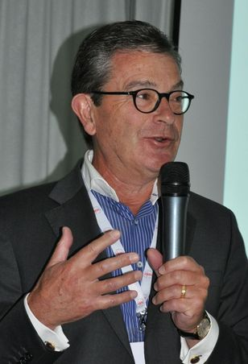

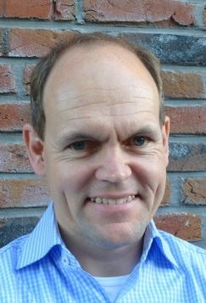
Foundation Board
Election by General Assembly in December 2017
Ludvig Josefsberg
President
Piet Steenaard
Treasurer/Secretary
Patrick Wouters
Vice-President
ExCo Member since 2010
ExCo Member since 1992
ExCo Member since 2010

Slide 11

Membership development
EHEDG membership is continuing to grow
EHEDG has a global reach
January 2018:
Over 1,500 main contact persons world-wide
390 individual members
495 member companies and institutes with
thousands of EHEDG resources behind

Slide 12
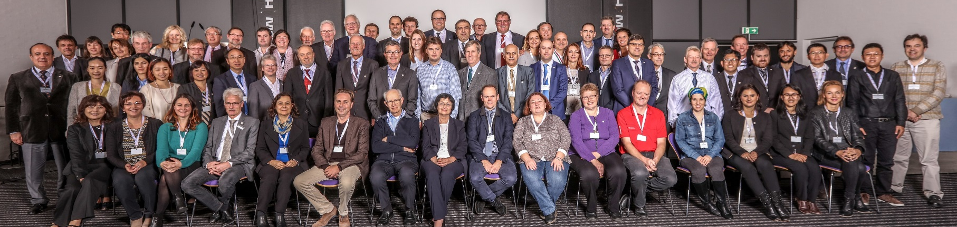
A global network
EHEDG is growing world wide and has members in 55 countries today
Existing Regional Sections (32):
  Argentina
  Armenia
  Austria
  Belgium
  Brazil
  Bulgaria
  China
  Croatia
  Czech Republic
  Denmark
  France
  Germany
  India
  Italy
  Japan
  Lithuania
  Macedonia
  Mexico
  Netherlands
  Nordic (FI, S, NO)
  Poland
  Romania
  Russia
  Serbia
  Spain
  Switzerland
  Taiwan
  Thailand
  Turkey
  Ukraine
  UK & Ireland
  Uruguay

Slide 13



A global network
Existing Regional Sections Europe (23)
Armenia
Austria
Belgium
Bulgaria
Croatia
Czech Republic
Denmark
France
Germany
Italy
Lithuania
Macedonia
Netherlands
Nordic (FI, NO, SE)
Poland
Romania
Russia
Serbia
Spain
Switzerland
Turkey
UK & Ireland
Ukraine

Slide 14


A global network
Existing Regional Sections America (4) & Asia (5)
China
India
Japan
Taiwan
Thailand
Argentina
Brazil
Mexico
Uruguay

Slide 15


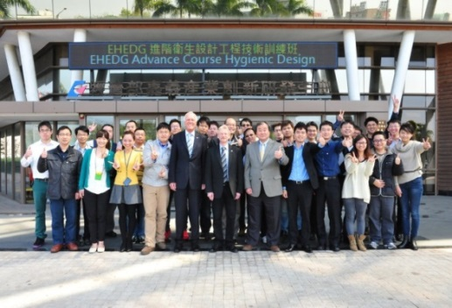
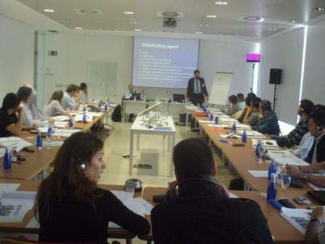
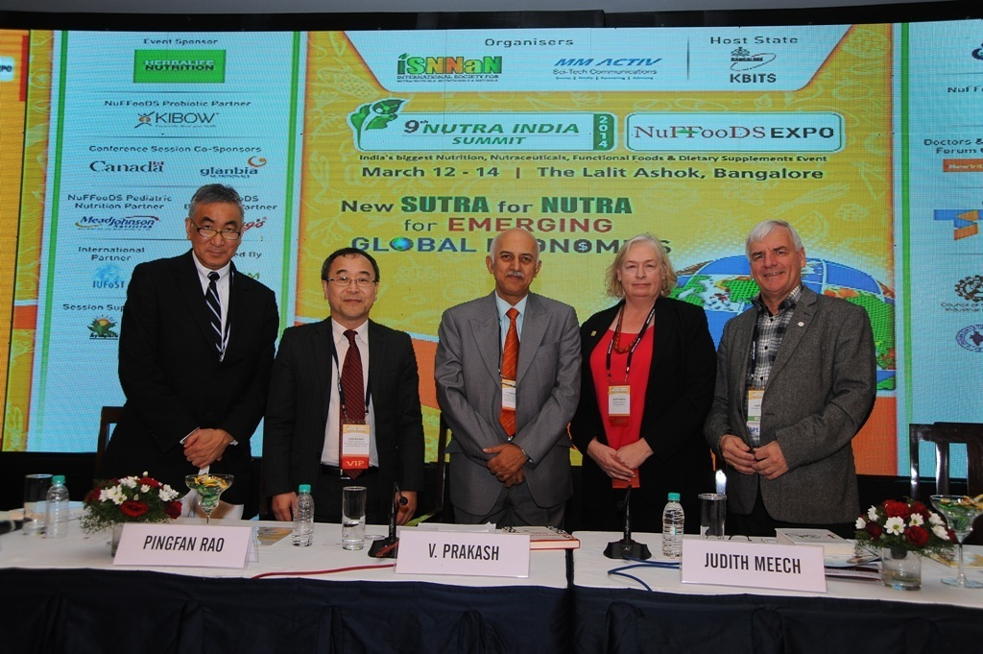
European Hygienic Engineering & Design Group
Regional development
Objectives
  Increase the local awareness and recognition of EHEDG
  Raise the importance of and knowledge in safe food
  production
  Provide guidance and support to local stakeholder
  Enhance the cooperation between Regional
  Sections
  Provide support to continuous development of
  EHEDG International

Slide 16
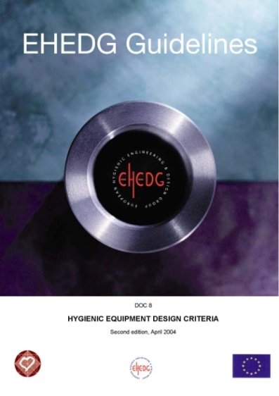
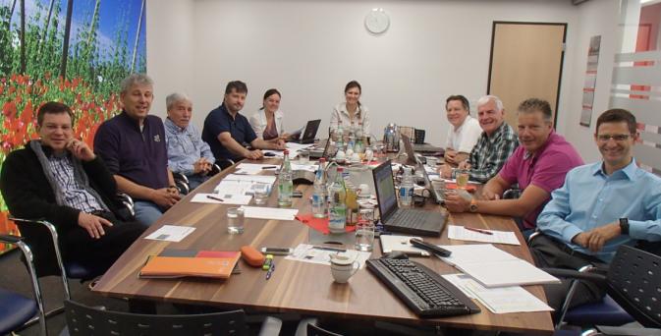
Product Portfolio
3 Main Areas
Guidelines
Testing & Certification
Training & Education
Some facts
21 working groups
46 published guidelines
(with 10 currently being updated)
400 volunteers participating
> 400 equipment / components certified

Slide 17


Product Portfolio
Objectives
Ensure high quality of guidelines, training materials, and certification services - Transparent and unambiguous
Define, plan and schedule updates and developments of product portfolio activities, documents and procedures
Initiate and assist with establishment and
management of working groups to assure
participation of all stakeholders
Establish procedures and guidance to assure
uniformity of presentation and coordination across
all product portfolio documents and services

Slide 18
Focus areas of Guideline Working Groups
Continuous development and updating
General
General Principles, Materials, Surfaces
Test
Methods
Factory Design incl. Design of Utility Systems
Closed Equipment for Liquid Food
Glossary
Doc. 8, 9, 18, 23, 32, 34, 35, 39
Doc. 10, 14, 16, 17, 20, 25, 37, 42
Doc. 2, 5, 7, 19
Doc. 27, 28, 44, 47
Closed Equipment for Dry Particulate Materials
Open Equipment
Packaging Machinery incl. Filling Machinery
Heat Treatment
Cleaning & Validation
Doc. 22, 31, 33, 36, 38, 40, 41
Doc. 13, 43, 49
Doc. 3, 11, 21, 29
Doc. 1, 6, 12, 24
Doc. 45
Training & Education
All EHEDG Documents

Slide 19
European Hygienic Engineering & Design Group
Continuous Process
Projected
Hygienic Design of Food Bulk Tankers
Recently started
Meat Processing, Foreign Bodies
Work in progress
Bakery Equipment, Cleaning in Place, Dry Materials Handling*, Food Refrigeration, Hygienic Systems Integration* (Doc. 34), Materials in food contact* (Doc. 32), Tank Cleaning, Test methods, Valves* (Doc. 14+20), Packaging Machinery* (Doc. 3, 11, 21), Pumps* (Doc. 17), Lubricants* (Doc. 23), Cleaning Validation (supplements to Doc. 45), Cleaning & Disinfection, Mechanical Seals* (Doc. 25)
In a final stage
Recently published
Hygienic Design Principles* (Doc. 8), Welding* (Doc. 9+35), Elastomeric Seals (new Doc. 48), Rotary Valves for Dry Materials* (Doc. 31), Water Management* (Docs. 27+28), Sensors* (Doc. 37), Packaging Machinery (new Doc. 46)
Fish Processing (new Doc. 49), Cleaning Validation Principles (Doc. 45), Air Handling (Doc. 47), Heat Treatment* (Doc. 1+6), Rotary Valves for Dry Materials* (Doc. 38)
Building Design Doc. 44
Conveyor Systems Doc. 43
Cleaning Validation Doc. 45
Air Handling (Update Doc. 30) Heat Treatment (Update Doc. 1 & 6)
Welding (Update Doc. 9 & 35)
* = Update of existing documents
Today: Over 400 voluntary experts actively involved in 21 Working Groups
47 guidelines published (4 withdrawn in 2016)

Slide 20
Focus areas of Training & Education
Continuous development and improvement of proprietary course modules on all guideline contents
Case Studies Drawings, hands on equipment, hands on pilot plant
Hygienic Design Checklist
E-learning
Picture Database (for training material and guidelines)

Slide 21
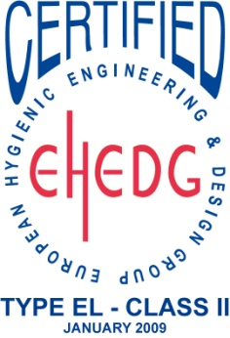
Focus areas of Testing & Certification
Continuous development and improvement of Testing & Certification procedures
Development of a test method for open equipment (started in 2016)
Establishment of new test institutes world-wide
Centralisation of EHEDG Certification
Development of a test method for equipment in open processing (started in 2016)
Implementation of a 5 year’s renewal
cycle for all certificates

Slide 22
Position of EHEDG in Food Safety Management
HACCP
WHAT
Pre-requisite Programs
“Standards”
Opportunity to harmonize GFSI requirements with the EHEDG Certification Scheme
CD
CS
RET
Cat Execs
Log Ex
Planners
Business case:
Securing
Customer Engagement;
Best practice (summary)
benefits
e.g. McCurrach reports
tbc
EHEDG Guidelines
“Good Practises”
tbc
HOW
Ongoing analysis; NPD; Promo
Factory Site / Standard Operating
Procedures / Work Instructions

Slide 23
15 Pre-Requisite Programs
PAS 220 is a Prerequisite Program Specification (PRP) which has a new name: ISO/TS 22002-1.
Construction and layout of buildings and associated utilities
Layout of premises, including workspace and employee facilities
Supplies of air, water, energy and other utilities
Supporting services, including water and sewage disposal
Suitability of equipment and its accessibility for cleaning, maintenance and preventative maintenance
Management of purchased materials
Measures for the prevention of cross-contamination
Cleaning and disinfection [sanitization]
Covered by the EHEDG guidelines
Pest Control
Personnel Hygiene
Rework
Product Recall procedures
Warehousing
Product information and consumer awareness
Food defense, biovigilance and bioterrorism

Slide 24
European Hygienic Engineering & Design Group
Working Groups
Active:
Air Handling
Bakery Equipment
Cleaning in Place
Cleaning Validation*
Cleaning & Disinfection
Dry Materials Handling*
Food Refrigeration*
Foreign Bodies
Hygienic Systems Integration*
Hygienic Design Principles (Update of Doc. 8)*
Materials of Construction in Contact with Food*
Meat Processing
Mechanical Seals*
Seals
Sensors*
Tank Cleaning
Test Methods
Training & Education
Valves*
Water Management*
Welding**
* = Update of existing documents
** = Draft under final review / subject to publication
Today: Over 400 voluntary experts actively involved in 21 Working Groups
47 guidelines published

Slide 25
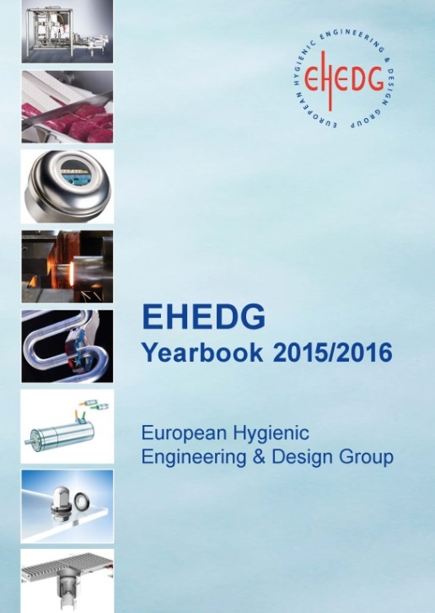
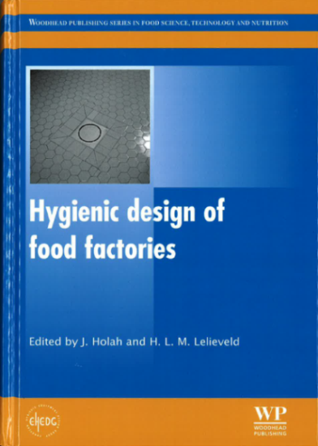

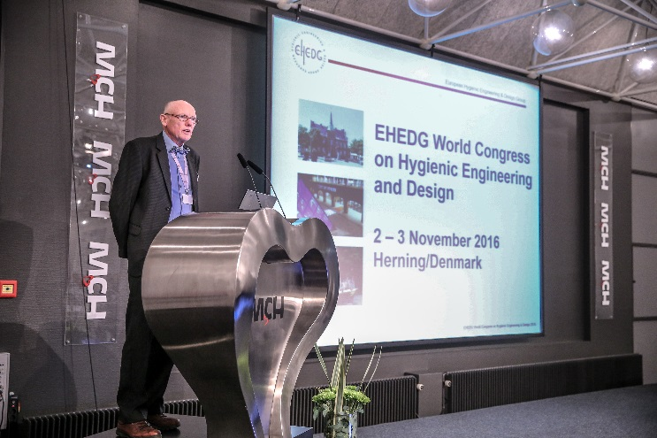
Communication
Responsible for strategy regarding
Membership Relations
External Communication
Internal Communication Tools
EHEDG International Events

Slide 26

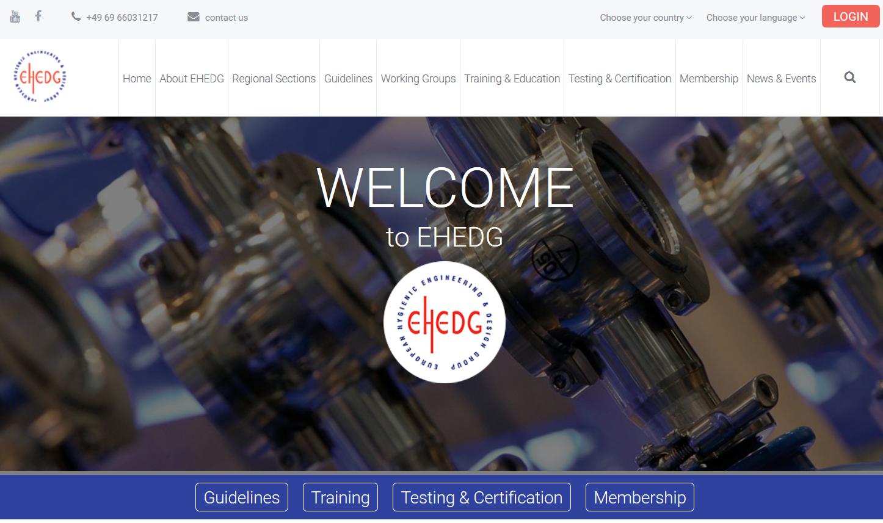
European Hygienic Engineering & Design Group
Website
The website www.ehedg.org is the major EHEDG
information and communication platform

Slide 27

You are welcome to join us!
Online Registration:
www.ehedg.org > Membership > Company Membership or
> Institute Membership
Thank You!

Slide 28



For questions or further information please contact us:
  EHEDG Secretariat, c/o VDMA
  Lyoner Strasse 18
  60528 Frankfurt am Main
  Germany
  Susanne Flenner
  Head Office Manager
  secretariat@ehedg.org
  Phone: +49 69 6603-1217
  Jana Huth
  jana.huth@ehedg.org
  Phone: +49 69 6603-1430
  Johanna Todsen
  johanna.todsen@ehedg.org
  Phone: +49 69 6603-1882
www.ehedg.org

Slide 29

Thank You!
Any Questions?

